Slide 1
Object-oriented Programming
Week 10 | Lecture 1

Slide 2
Defining Aliases
The keyword typedef can be used to declare synonyms (aliases) for previously defined data types
Creating a name using typedef does not create a new data type; typedef creates only an alternate name for the existing data type

Slide 3
Example
int main()
{
typedef int i;
i var1 = 5;
cout << var1; // outputs 5
typedef float f;
f var2 = 2.8;
cout << var2; // outputs 2.8
}

Slide 4
Stream I/O
C++ is a type-safe language
I/O in C++ occurs in streams
Streams are simply sequence of bytes
In input operations, data is transferred from input device (keyboard) to main memory
In output operations, data is transferred from main memory to output device (display screen)

Slide 5
Stream I/O
C++ provides both low-level (unformatted) and high-level (formatted) I/O capabilities
Unformatted I/O is efficient for high-volume data processing
C++ includes the standard stream libraries for I/O operations

Slide 6
Stream I/O
The C++ iostream library provides a lot of I/O capabilities
The <iostream> header file defines the cin, cout, cerr and clog objects
The <iomanip> header declares services useful for performing formatted I/O with so-called parameterized stream manipulators

Slide 7
Stream Operators
The left-shift operator ( << ) is overloaded to serve as stream insertion operator
The right-shift operator ( >> ) is overloaded to serve as stream extraction operator
These operators are used with the standard stream objects cin, cout, cerr and clog

Slide 8
Standard Stream Objects
Predefined object cin is an istream instance
The object cout is an ostream instance
The predefined object cerr is an ostream instance and is said to be “connected to” the standard error device, normally the screen
The predefined object clog is an instance of the ostream class and is said to be “connected to” the standard error device. Outputs to clog are buffered

Slide 9
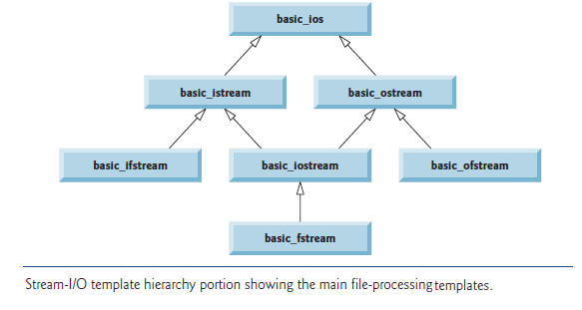

Slide 10
Output Stream
C++ determines data types automatically
But this feature can sometimes “gets in the way”

Slide 11
Example
int main()
{ char * word = “Hello”; cout << “Address is ” << word;
}
// prints Hello as output instead of address

Slide 12
Solution
Cast the char * to a void *
int main()
{ char * word = “Hello”; cout << “Address is ”; cout << static_cast< void *>(word);
} // prints address as output

